Slide 1



Department of Computer Science Engineering-Data Science
A Project Presentation
on
“Recipe Generator : ChefAI”
Presented by
Chetana H K | 3BR22CD007
K Shashikala | 3BR22CD023
Mounika M | 3BR22CD039
Pushpitha J R | 3BR22CD046
Under the Guidance of
Dr. D. Aradhana
Head of the Department
Dept. of CSE-DS

Slide 2
CONTENTS
ABSTRACT
OBJECTIVES
SCOPE OF THE PROJECT
TECHNOLOGY USED
PROJECT DESCRIPTION IMPLEMENTATION RESULT
CONCLUSION

Slide 3
ABSTRACT
The AI-Powered Recipe Generator is a smart web application developed using React and AI that helps users generate personalized recipes based on available ingredients, meal preferences, and dietary restrictions. The system uses Generative AI to create unique and well-structured recipes instantly. Users simply enter ingredients they have at home, choose the meal type and dietary preference, and the application generates a complete recipe including preparation time, ingredients list, cooking instructions, and chef tips.
.

Slide 4
OBJECTIVES
To develop an AI-based recipe generation system using Generative AI.
To provide personalized recipe suggestions based on available ingredients. To support different meal categories such as breakfast, lunch, dinner, snacks, and desserts.
To include dietary preferences like vegetarian, vegan, keto, gluten-free, and non-vegetarian options.
To create a responsive and user-friendly web interface using React.

Slide 5
SCOPE OF PROJECT
Developing a web-based intelligent cooking assistant capable of generating recipes dynamically using Artificial Intelligence.
The application can be used by:
Students living independently
Home cooks
Working professionals
Health-conscious users
People with dietary restrictions

Slide 6
TECHNOLOGY USED
Technology | Purpose
React.js | Frontend UI development
JavaScript | Application logic
HTML5 | Structure of web pages
CSS3 | Styling and responsive design
Google Gemini AI API | AI-based recipe generation
React Markdown | Rendering formatted recipes
Lucide React | Icons and UI enhancement
Vite | Fast frontend build tool

Slide 7
PROJECT DESCRIPTION
The application uses Google Gemini Generative AI to analyze the user inputs and create complete recipes instantly. The generated recipe includes recipe name, preparation time, ingredients list, cooking instructions, and chef tips in a well-structured format.
The frontend of the application is developed using React.js with an interactive and responsive user interface. The system also uses Markdown rendering to display recipes clearly and attractively.
This project helps users discover creative meal ideas, reduces food wastage by utilizing available ingredients, and demonstrates the practical implementation of Generative AI in real-world applications.

Slide 8
IMPLEMENTATION
User Inputs Ingredients
↓
Selects Meal Type & Dietary Preference
↓
React Form Collects Data
↓
Prompt Sent to Gemini AI API
↓
AI Generates Recipe
↓
Recipe Returned in Markdown Format
↓
ReactMarkdown Renders Recipe
↓
Recipe Displayed to User

Slide 9
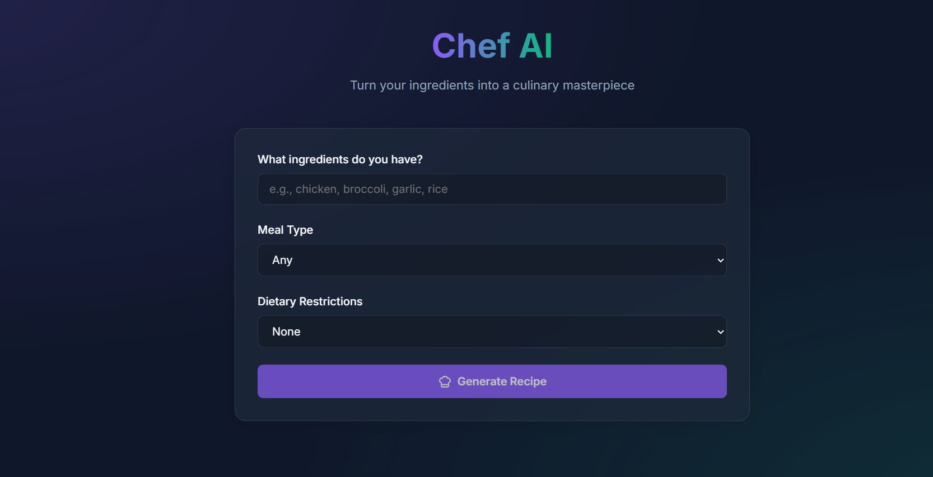
RESULT(OUTPUT SNAPS)
FIG 01: HOMEPAGE

Slide 10
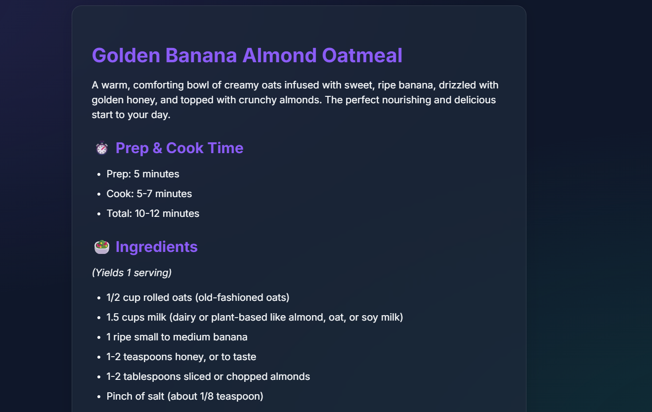
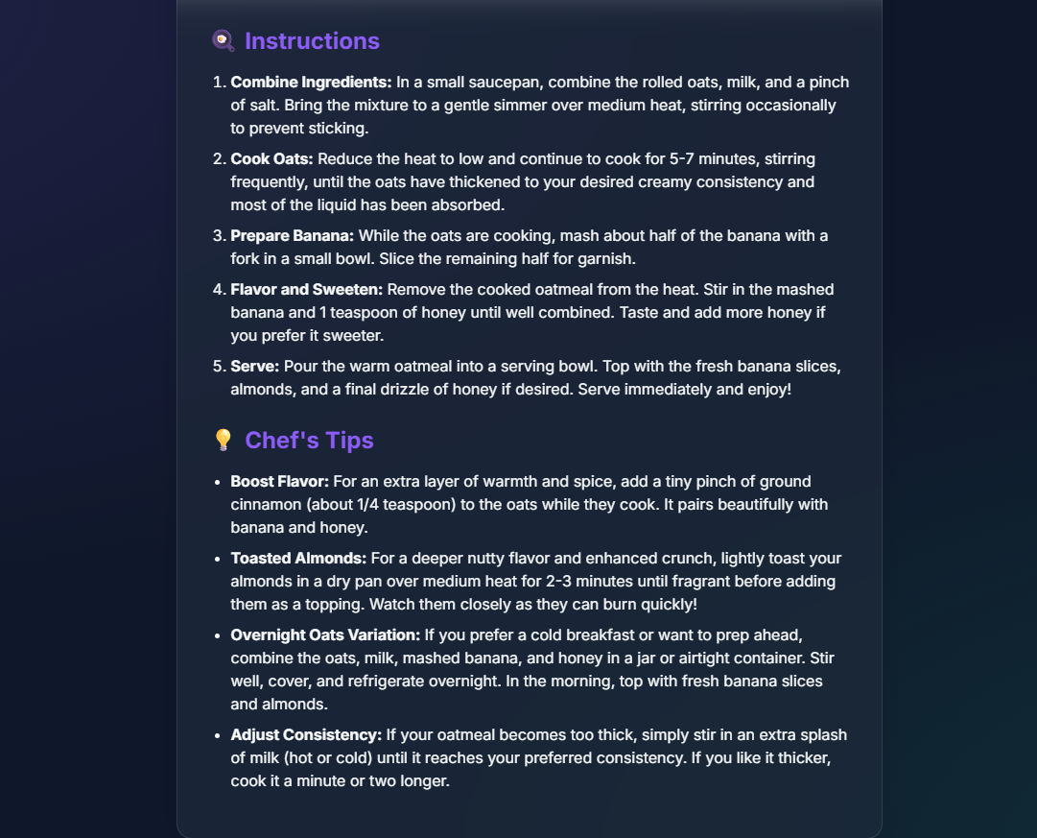

Slide 11
CONCLUSION
The Recipe Generator successfully demonstrates the integration of Generative AI with modern web technologies to create an intelligent and interactive cooking assistant.
The project showcases the practical use of Artificial Intelligence, Natural Language Processing, and prompt engineering in solving real-world problems such as meal planning and food wastage reduction. The system provides a user-friendly experience with fast and dynamic recipe generation capabilities.

